Slide 1



Integration of Biofeedback into a Videogame
to Improve Emotion Self-Regulation in Children
with Autism Spectrum Disorder

Slide 2

Motivation
ASD: fastest growing developmental disability
CDCP: prevalence of autism in the United States has risen from 1 in 150 births in 2002 to 1 in 68 births in 2012 (CDC, 2013)
Difficulty with social interaction, communication, motor and cognitive functioning, and emotion self-regulation, resulting in more frequent tantrum behavior
Focus on behavior and communication
Lack of effective intervention to promote the acquisition of emotion self-regulation skills
Notes:
Lisa

Slide 3
Progress
Addition of emotional situations
Superhero theme & reward system
New artwork, animations, characters, and scripts based on ASD research and collaboration with the Center for Autism and Neurodevelopment
Breathing exercise song accompaniment and biofeedback cues
Development of a superhero cape strain gauge harness
Notes:
kim

Slide 4
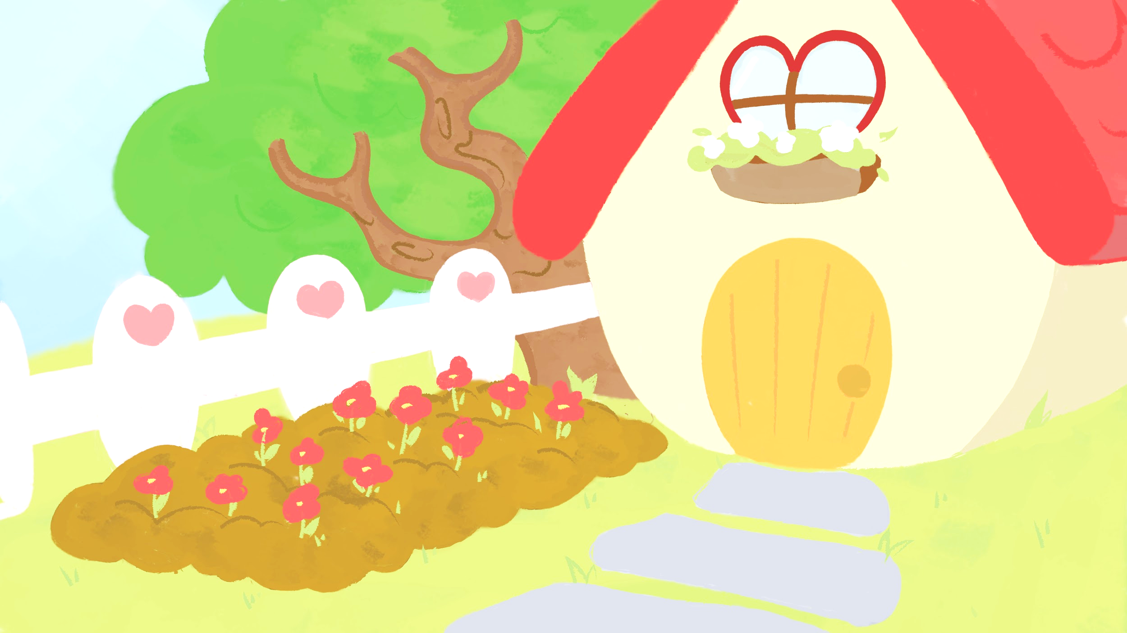
Our Approach
Advance interventions seeking to improve children's skills in regulating emotional responses
Reduce tantrum behaviors in children with ASD ages 4 to 8
Investigate the effects of diaphragmatic breathing on emotional states of children with ASD
Provide parents with an educational tool that will help their children recognize extreme emotional states
Notes:
Lisa

Slide 5

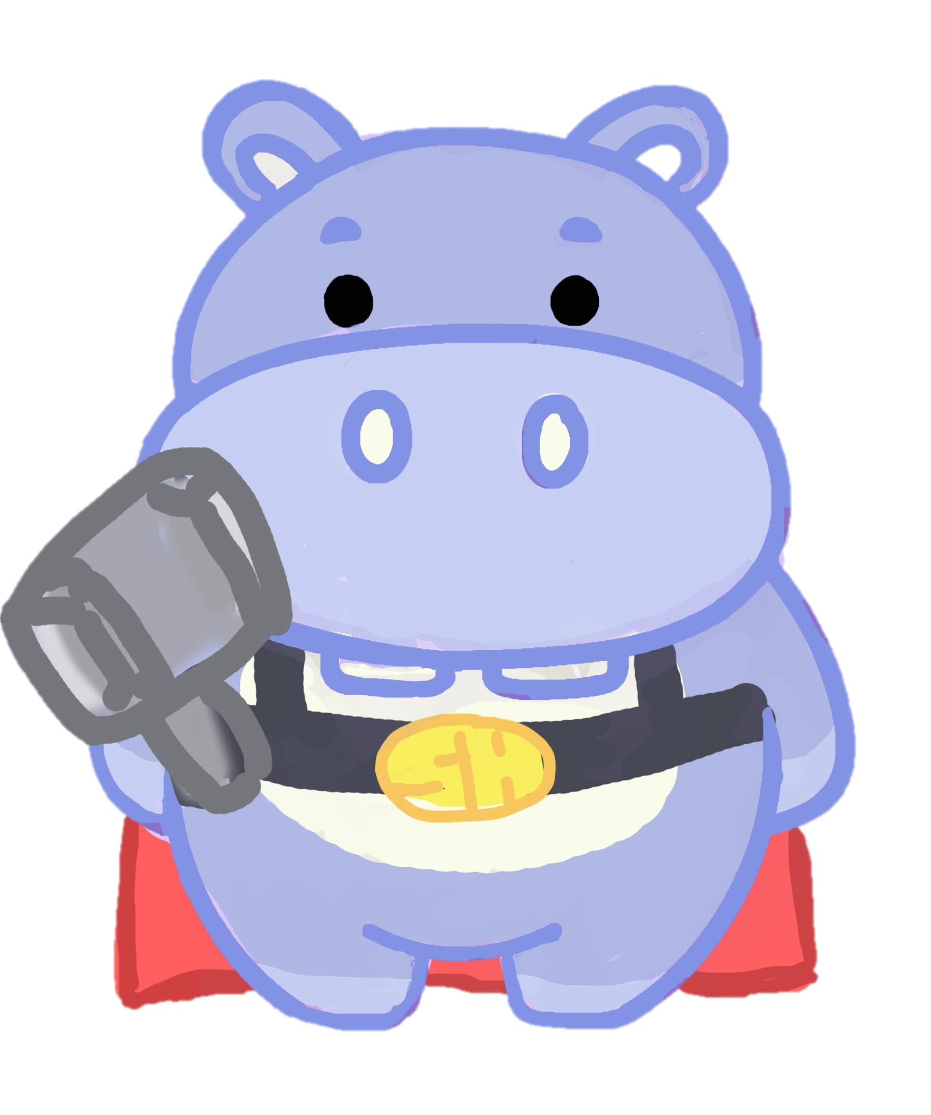
How are you feeling today?
Challenging Version:
First play-through when the child is in a good mood
The breathing exercise is introduced as a super-hero skill to be used to handle stressful situations
Examples include meeting a stranger, speaking with someone unfamiliar, being in a new, ‘scary’ environment, & getting disappointed
Challenges are not meant to be triggering
Non-Challenging Version:
Can be played after completing the challenging version
Played when not feeling well or just having fun
No emotional stress in the activities
The child can pick any location from the regular game to do a location specific breathing activity (blowing dandelions, blowing bubblegum bubbles, blowing up balloons, blowing out candles…)
Notes:
Marcella

Slide 6

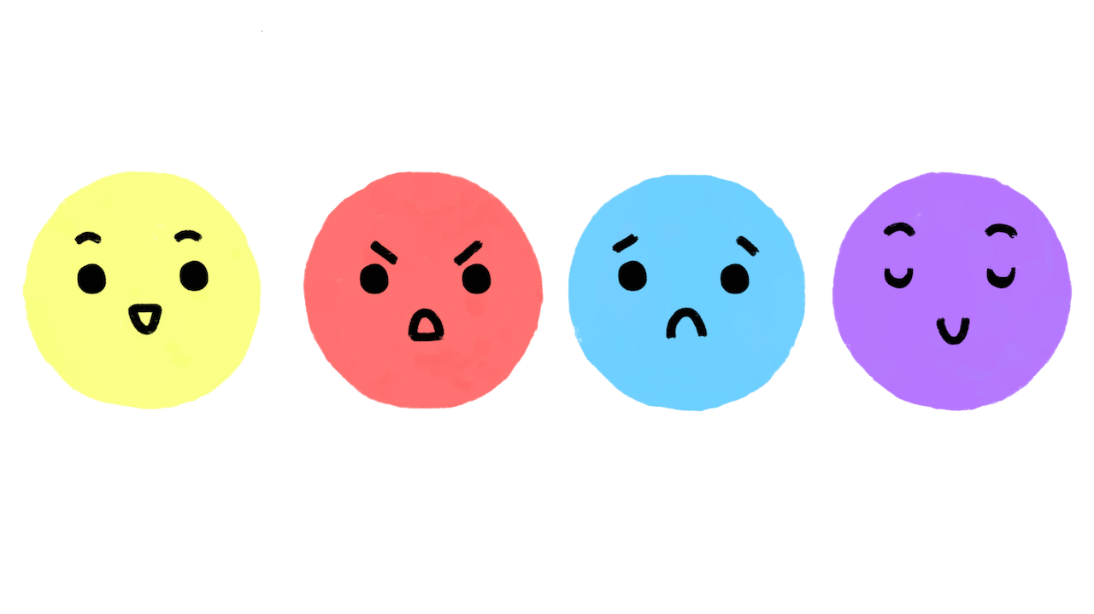


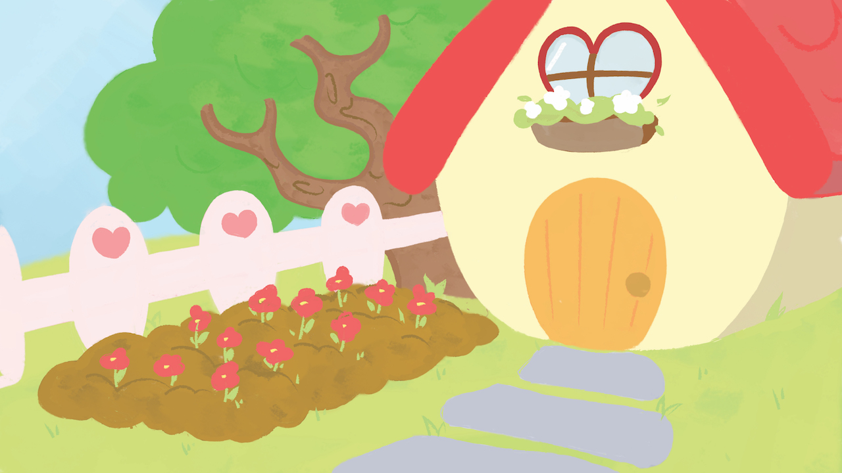

Start
IF positive mood
choice (2)
Challenging version
IF Negative mood choice(2)
or
Badges are given
Non-challenging version
Stickers are given
Notes:
Ayden
The start menu will appear
Start is pressed
The child selects an emotional state
The child is asked to evaluate his/her emotional state before and after gameplay
A face is chosen that corresponds to their mood
Negative emotions will lead to the non-challenging script
4. The map appears
If a negative emotion is chosen the non-challenging version starts
If a positive emotion is chosen the challenging version starts
5. The child clicks on a location and begins playing that scene

Slide 7


The Breathing Exercise
CBT breathing technique:
Four count inhale, hold for two, and exhale for four (repeat 4 times)
Error specific biofeedback:
Length & depth of breaths ( strain gauge cord)
Ring around hippo’s stomach
expands and contracts as the child breaths.
Ring changes color if the
child breathes improperly
Game teaches children a song
Notes:
What is the exercise? Why is it important? What is its role in the game? How does it work?
Marcella

Slide 8


The Song
“I fill my tummy though my nose.
Take a pause once it grows.
Then I blow the air all out
I feel calm without a doubt!”
Notes:
Marcella

Slide 9



Game Functionalities
Badges:
Awarded when a level is completed in the challenging version
Each the themes of the level
Stickers:
Non-challenging version
1-5 stickers are awarded depending on how well the child performs
Notes:
Big picture: the badges helps the child visualize progress (completion of a task)
Kim

Slide 10


Super Cape
Monitors breathing rate and diaphragmatic expansion and provides feedback on breathing exercise
Breathing pattern is visually represented on the screen with a colored ring around the Super Hippo’s belly
Instructions for the breathing corrections are displayed on the screen based on the feedback
Records breathing data that can be used to track improvement and common technique problems
Notes:
Lisa

Slide 11




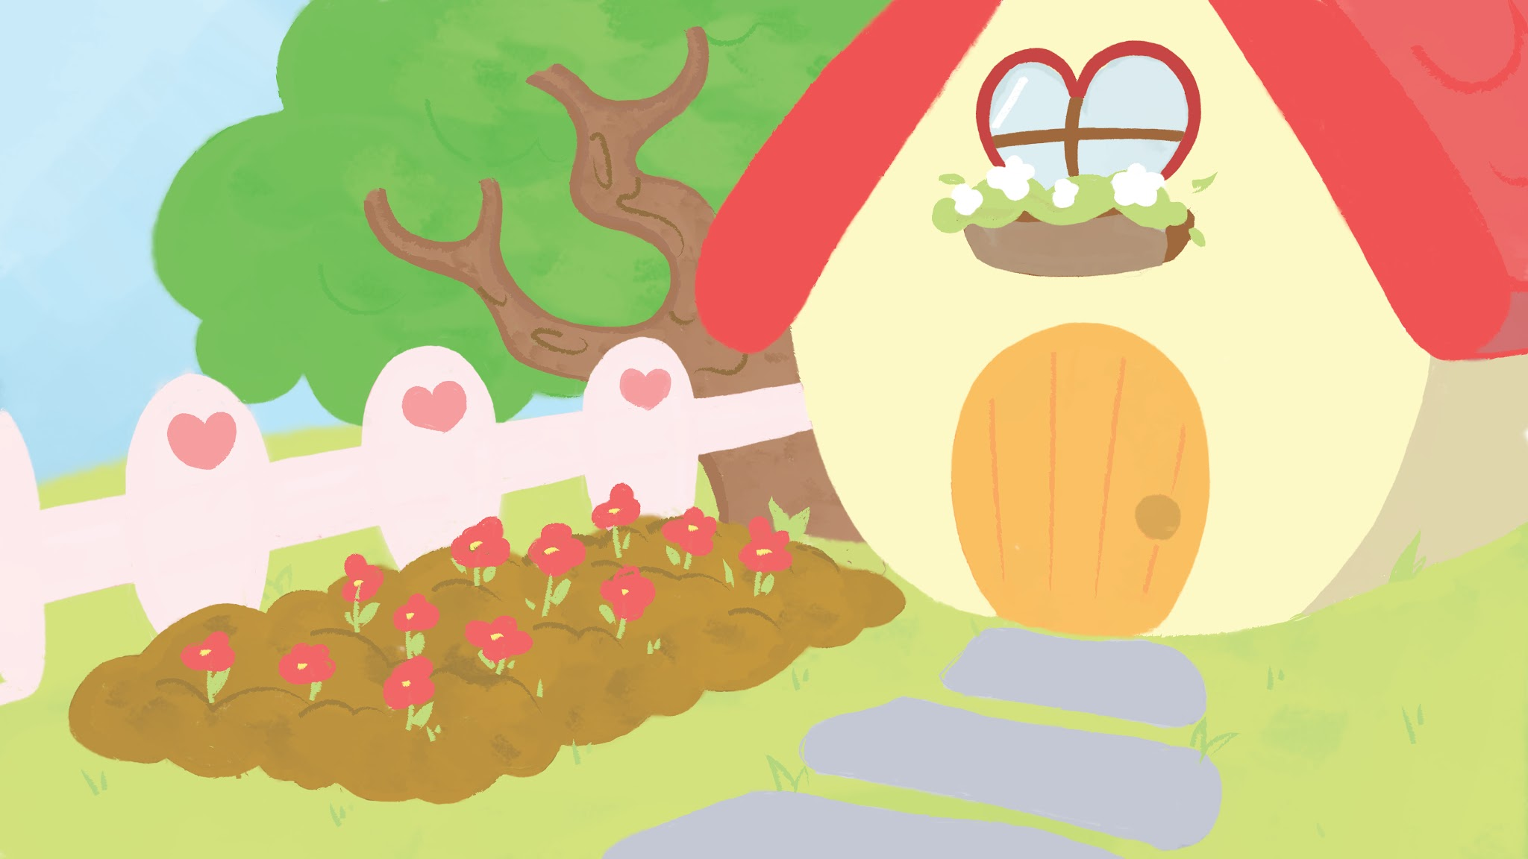
The Art
Colors are used in association with specific emotions and correlated to the characters
Light, gentle tones are used throughout the game
The backgrounds are bright and warm, to be comforting and encouraging
Notes:
Kim

Slide 12
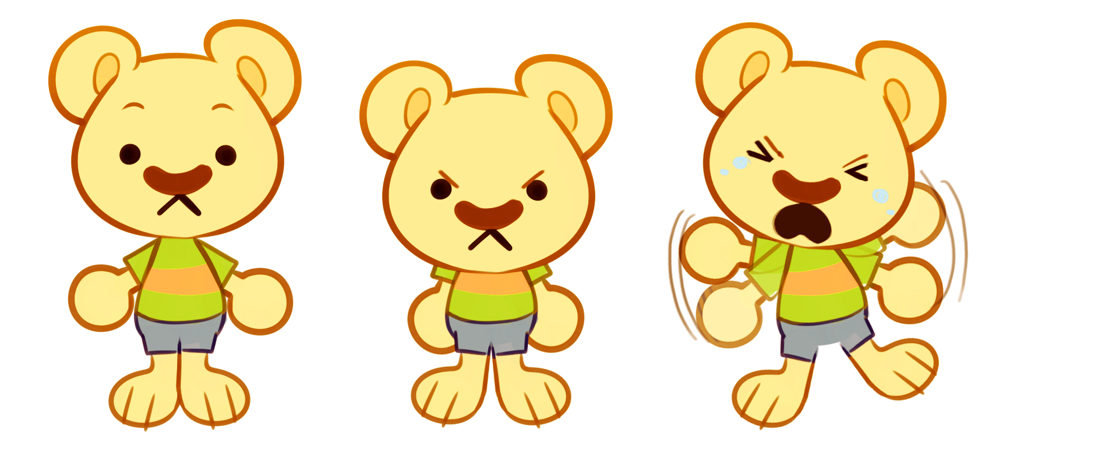
Expression and Animation
“It has also been suggested that those with ASC focus on the mouth during social exchanges because they may be trying to obtain verbal information”
-Enhancing Emotion Recognition in Children with Autism Spectrum Conditions: An intervention Using Animated Vehicles with Real Emotional Faces
“Results of both studies showed that children with ASD performed as well as their TD peers on the Body-Emotion test.”
-Peterson, C., V. Slaughter, and C. Brownell. "Children with Autism Spectrum Disorder Are Skilled at Reading Emotion Body Language."
“Finally, the correct identification of neutral faces appeared to be particularly challenging for those with ASD, with affected individuals more frequently identifying neutral faces as angry”
-Eack, Shaun M., Nancy J. Minshew, and Carla A. Mazefsky. "Misinterpretation of Facial Expressions of Emotion in Verbal Adults with Autism Spectrum Disorder."
The characters’ mouths will not animate as they speak
The hippo’s mouth will only show for the breathing activities
Body expressions are used to show emotions
Emotions will be verbally described to minimize misjudgment
Notes:
Kim

Slide 13
Demo
Notes:
Ayden

Slide 14

The Team
Jessica Kernan (Informatics), Project Manager
Ayden Zhang (Informatics), Programmer
Kevin Liu (Engineering), Programmer
Kim Zhang (Business Administration), Artist, Animator
Erin Shin (OCSA), Artist
Tina Chau (Art), Animator
Lisa Harvey (Psychology), Scriptwriter, Cape Creator, Composer
Marcella Digel (Biomedical Engineering - Premed), Scriptwriter, Background Researcher
Drs. Yuqing Guo, Sergio Gago, & Professor Robin Steinberg-Epstein, Mentors

Slide 15

Thanks!

